Slide 1


SRM VALLIAMMAI ENGINEERING COLLEGE
(An Autonomous Institution)
DEPARTMENT OF
ELECTRONICS AND INSTRUMENTATION ENGINEERING EI6811- PROJECT WORK
DITTO – THE ADVANCED LEAD THROUGH ROBOT
ZEROTH REVIEW
DATE : 02-02-2021
TEAM MEMBERS
A.A.ISHWARYA | (412817107024)
R. HARINI | (412817107023)
S. KAVYA | (412817107030)
UNDER THE GUIDANCE OF
R. ISSANRAJ A.P (SR.G)

Slide 2
Abstract
Recently robots are widely used in a various field particularly in the industry. Despite this fact robot still requires an undeniable amount of knowledge from the operators or workers who deal with them.
As a result, robots cannot be easily programmed if the operator or the worker is not experienced in robotics field. One of the programming methods that has been introduced to make programming task user friendly is lead-through robot programming. However, the existing lead-through programming methods still requires an amount of knowledge that is not available for most of the operators and workers.
The main objective of this project is to design a lead through method for point to point robot programming using angular and dimensional scaling of an real-time robot to a scaled down model, which can record, save and playback the robot motion while considering the accuracy and precision of the robot. This root the workers to not strain to program the robot by lead through the nose of huge real-time robot but through the scale downed duplicate. This ensures the method of programing much easier to use since, users need not to strive on robots.
On the actual scenario of programing, the real-time robot offers resistance to motion which causes the operator to strain to move it to required positions. This issue can be overcome through this scaling method with greater reduction in latency of relocating the nose trajectory.

Slide 3
Existing system
Simulation/Offline Programming
Programming offline does not interfere with production too much. Offline programming allows the robot to be programmed using a virtual mockup of the robot and task. If the simulation software is intuitive to use, this can be a quick way to test an idea before moving it to the robot.
Teaching Pendant/Drive Through
over 90% of robots are programmed using this method. Often consists of a giant handheld calculator. To program the robot, the operator moves it from point-to-point, using the buttons on the pendant to move it around and save each position individually. When the whole program has been learned, the robot can play back the points at full speed.
Teaching by Demonstration/Lead Through
These methods involve moving the robot around, either by manipulation a force sensor or a joystick attached to the robot wrist just above the end effector. As with the teach pendant, the operator stores each position in the robot computer as it is easy for operators to get started immediately using the robot with their applications.

Slide 4
Proposed system
An update on Teaching by Demonstration / Lead through method of programming.
Rather than moving a real time robot’s end effector with our muscular efforts, we can make a scaled down model in order to achieve the same motion in a simple way.
This method will be much easy, convenient and highly flexible to program a robot with non purposeful, wide application oriented situations.
Through this method, we can reduce the halted time of the industrial robot.
It will not require skilled craftspeople who are unfamiliar with programming.
Quicker than traditional teach pendants. We can reduce the end up wasting time sorting out by the old simulator issues instead of solving production challenges.
It reduces the need for multiple button pressing, allowing the operator to simply move the robot to the desired position.
Very good for detailed tasks which would require many lines of code to achieve the same effect, such as welding or painting of intricate shapes.

Slide 5
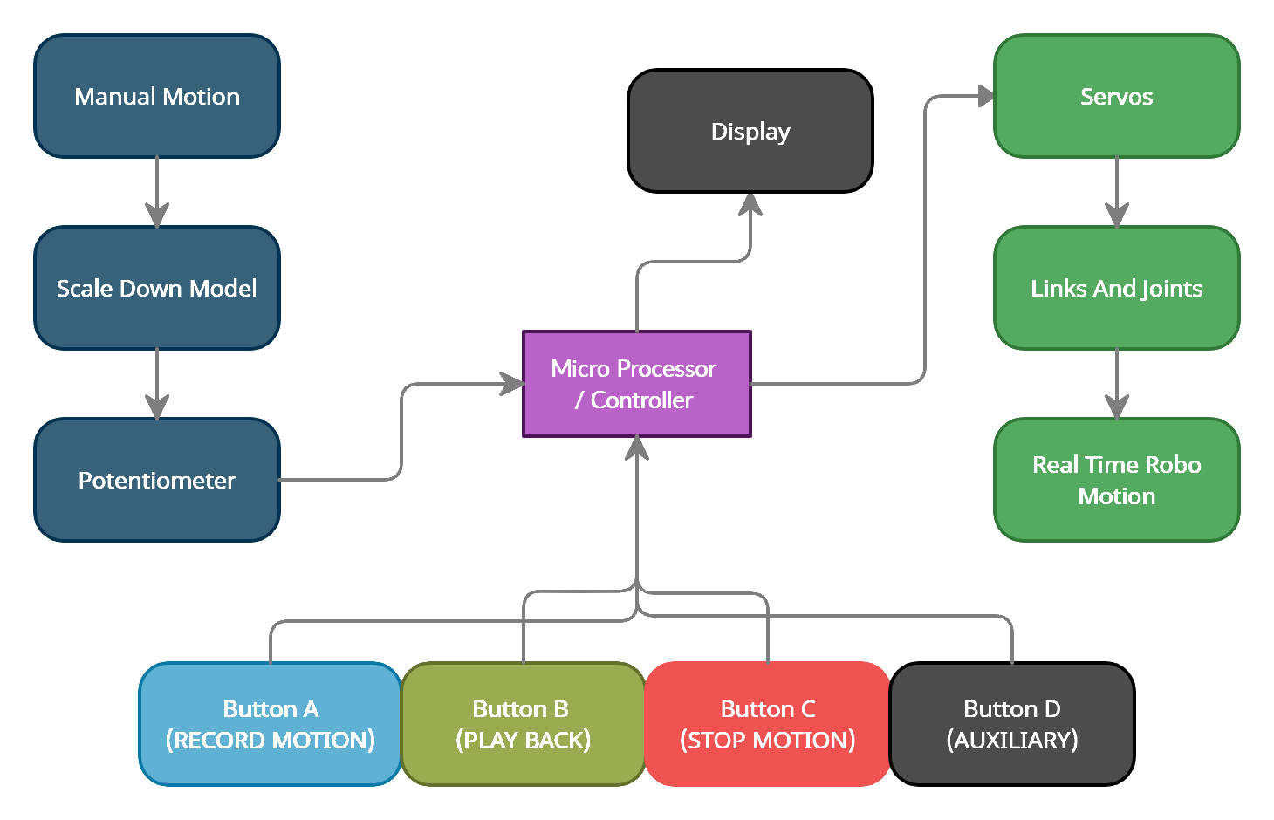
Block Diagram

Slide 6
Objective :
The main objective of this project is to build a robot that will be embedded with a robotic arm and can be controlled using new lead through method.
The robot can move to remote places and do the pick & place action of objects that are dangerous and harmful. The applications of this project is vast and can be implemented in a lot of industries.
To create a pick and place robot with lead through method for point to point robot programming using angular and dimensional scaling of an real-time robot to a scaled down model.
To increase the pick-and-package global performance in terms of flexibility, dependability and error reduction.
Improvement of the working conditions of operators by a proper layout design and task allocation between worker and robot.

Slide 7
LITERATURE SURVEY:
“A REVIEW ON DESIGN AND DEVELOPMENT OF PICK AND PLACE ROBOTIC ARM” by Prof. S.D Rajgure1 , Aakash D Chougale, Ajit N Bhatkande, Suraj A Bhamare, Swaroop S Chougale. This paper let us to know the forward and inverse kinematics of robot arm motion. It is helpful to calculate the load carried by arm during its work time. shows the method for reducing the total energy consumption of pick and placed robotic arm.
“DEVELPOMENT OF PICK AND PLACE ROBOT FOR INDUSTRIAL APPLICATIONS” by Vishakha Borkar, Prof G.K.Andurkar. This paper let us to know the Law of robotics, Key components of a robot, Model for mechanical gripper.
“ROBOTIC ARM FOR PICK AND PLACE APPLICATION” by Kaustubh Ghadge, Saurabh More, Pravin Gaikwad, Shrenik Chillal. This paper let us to know the Robot types, Problems faced, Robotic arm and base development , Microcontroller and Servo motors.
BEEE book by j b gupta for learning electronics and implementing them in project.

Slide 8
Hardware
Arduino Mega
Raspberry Pi
High torque digital servos
Pick and place robot frame
LCD display
Switches, Wires, resistors, Potentiometer
TTL converter
Other accessories.
Arduino IDE 1.8.13
Raspberry Pi OS
Software

Slide 9
References
Alexander Skoglund,Boyko Iliev,Bourhane Kadmiry,Rainer Palm, ‘Programming by Demonstration of Pick-and-Place Tasks for Industrial Manipulators using Task Primitives’, 2007 International Symposium on Computational Intelligence in Robotics and Automation.
Pei-Chi Huang,Aloysius K. Mok, ‘A Case Study of Cyber-Physical System Design: Autonomous Pick-and-Place Robot’ , 2018 IEEE 24th International Conference on Embedded and Real-Time Computing Systems and Applications (RTCSA).
Peng Hao; Tao Lu; Yinghao Cai; Shuo Wang, ‘Programming by Visual Demonstration for Pick-and-Place Tasks using Robot Skills’, 2019 IEEE International Conference on Robotics and Biomimetics (ROBIO)
Mahmoud Abdelaal,‘A Study of Robot Control Programing for an Industrial Robotic Arm’ 2019 6th International Conference on Advanced Control Circuits and Systems (ACCS) & 2019 5th International Conference on New Paradigms in Electronics & information Technology (PEIT)
Chaitanya S. Gajbhiye; Megha G Krishnan; S. Kumaravel; S. Ashok‘Fuzzy — Arduino based control strategy for human safety in industrial robots, 2017 IEEE International Conference on Signal Processing, Informatics, Communication and Energy Systems (SPICES)

Slide 10
References
Luka Peternel; Tadej Petrič; Jan Babič, ‘Human-in-the-loop approach for teaching robot assembly tasks using impedance control interface’, 2015 IEEE International Conference on Robotics and Automation (ICRA).
Martin Tykal; Alberto Montebelli; Ville Kyrki, ‘Incrementally assisted kinesthetic teaching for programming by demonstration’, 2016 11th ACM/IEEE International Conference on Human-Robot Interaction (HRI)
Christian Kohrt; Anthony Pipe; Gudrun Schiedermeier; Richard Stamp; Janice Kiely, ‘A robot manipulator communications and control framework’, 2008 IEEE International Conference on Mechatronics and Automation
Y. Kuniyoshi; M. Inaba; H. Inoue, ‘Learning by watching: extracting reusable task knowledge from visual observation of human performance IEEE Transactions on Robotics and Automation ( Volume: 10, Issue: 6, Dec 1994)
Rahul Kumar; Sunil Lal; Sanjesh Kumar; Praneel Chand,’ Object detection and recognition for a pick and place Robot Asia-Pacific World Congress on Computer Science and Engineering

Slide 11


